Slide 1
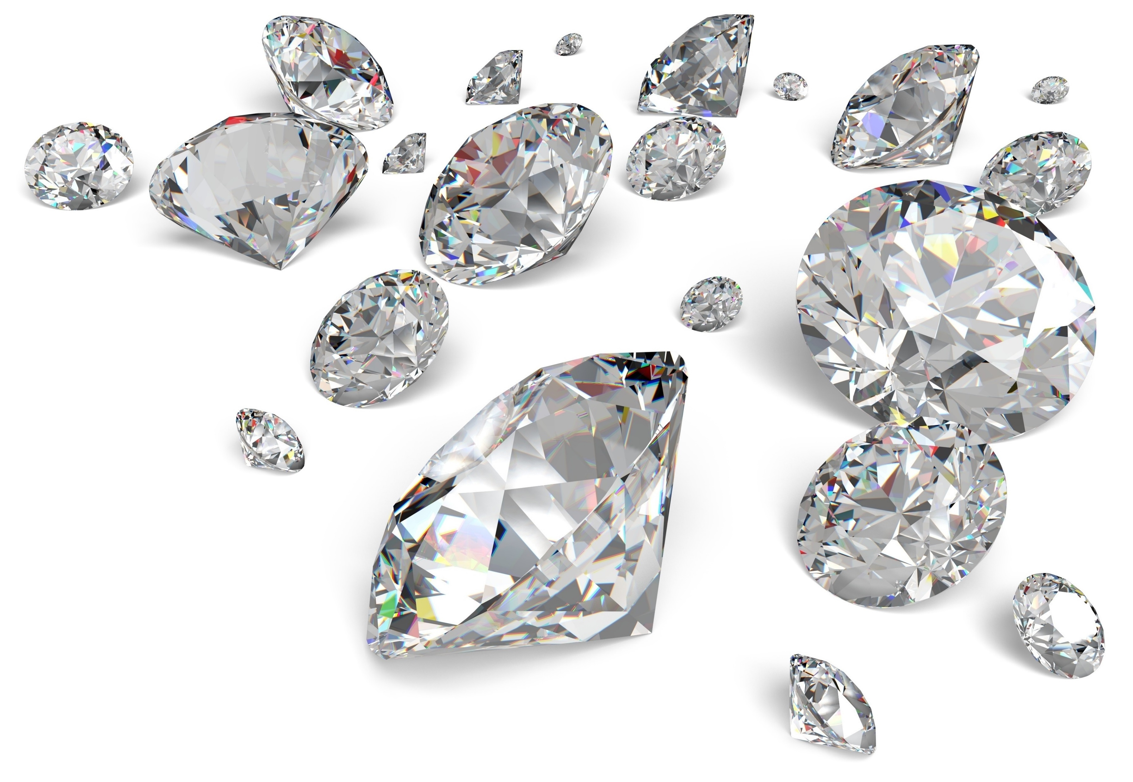
Diamonds
…are a data scientist’s best friend?

Slide 2
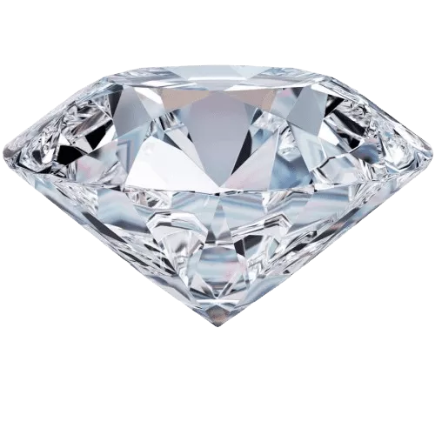
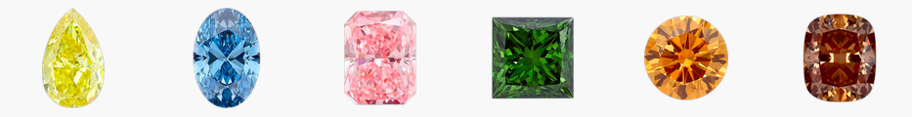
The largest diamond dataset currently on Kaggle
219,703 graded diamonds
25 columns (14 used in analysis)
Mixture of “fancy” (colored) and traditional (clear) stones
traditional
fancy
Notes:
cut, color, and clarity are all ordered categorical variables

Slide 3
Columns
Columns not discarded during data cleaning:
color: The graded diamond color. Applies to clear diamonds only.
clarity: The amount of internal imperfections visible with jewelers loupe.
carat weight: The mass of a diamond. 1 carat is 200 milligrams.
cut quality: The degree to which the diamonds cut (or shape) is to perfection.
symmetry: How close is the diamond is to being perfectly symmetrical.
polish: The degree of surface scratches or inclusions present.
cut: The cut of the diamond. Alternatively called its shape.
dominant color: The primary color for a fancy diamond
culet size: The pointed facet at the bottom of a diamond.
depth percent: The diamond's total height divided by its total width.
table percent: The flat part of diamond's area as a percent of its overall footprint.
girdle min: The thickness of the thinnest section that divides the upper section (crown) from the bottom (pavilion).
girdle max: The thickness of the thickest section that divides the upper section (crown) from the bottom (pavilion).
total sales price: Total price for the stone, priced in dollars.
ordered categorical (‘ordinal’)
unordered categorical (‘nominal’)
continuous numeric
Notes:
(not relevant, too many null values, highly correlated with other variables).

Slide 4
Initial cleaning & prep

Slide 5
Initial cleaning
Removed NaN values, first column-wise then rows.
Removed duplicated rows.
Removed lab column (assume this has no effect on values).
Encoded categorical variables:
Ordered categorical values use label encoding (1, 2, 3,…) to preserve order.
Variables ordered from worst to best so that poorer ratings would correspond with lower numbers.
Unordered categorical values use dummy (‘one-hot’) encodings.
Removed height, width, and depth, being highly correlated with carat weight.

Slide 6
Classification Models
Predicting fancy/clear

Slide 7
Predicting fancy/clear
If we know the diamond specs not related to color, and the purchase price, can we predict if it was a fancy or clear diamond?
Used columns only applicable to both clear and fancy diamonds.
Removed color encoding columns
Removed ‘is_fancy’ column

Slide 8
Common columns
clarity: The amount of internal imperfections visible with jewelers loupe.
carat weight: The mass of a diamond. 1 carat is 200 milligrams.
symmetry: How close is the diamond is to being perfectly symmetrical.
polish: The degree of surface scratches or inclusions present.
depth percent: The diamond's total height divided by its total width.
table percent: The flat part of diamond's area as a percent of its overall footprint.
total sales price: Total price for the stone, priced in dollars.
shape: The cut of the diamond (dummy-encoded).
dominant_color: ‘green’, ‘purple’, etc., or ‘clear’ for traditional diamonds (dummy-encoded).
is_fancy: Boolean reduction of dominant_color: ‘clear’ is False, all others are True
ordinal categorical
continuous numeric
nominal categorical
Boolean
shape encodings
color encodings
shape_Asscher
shape_Cushion
shape_Cushion_Modified
shape_Emerald
shape_Heart
shape_Marquise
shape_Oval
shape_Pear
shape_Princess
shape_Radiant
shape_Round
color_Black
color_Blue
color_Brown
color_Chameleon
color_Gray
color_Green
color_Orange
color_Other
color_Pink
color_Purple
color_Red
color_Yellow
color_clear
Notes:
(not relevant, too many null values, highly correlated with other variables).

Slide 9
Multiple models
3 supervised models
Balanced Random Forest – all features
Balanced Random Forest – without shape
Support Vector Classifier
1 unsupervised model
K-means clustering

Slide 10
Notes
K-means returns clusters, identified by cluster labels (0, 1).
I mapped cluster labels to Boolean values by assigning each cluster to the dominant value of ‘is_fancy’ (True, False) in that cluster.
SVC and K-means are both distance-based, however this time I stuck with Euclidean distance, even though most of the data is ordinal, for simplicity.

Slide 11
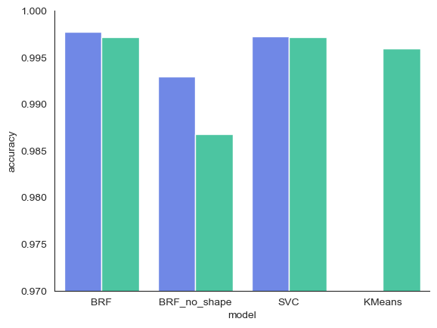
Results
training accuracy
testing accuracy
0.995

Slide 12
Classification conclusions
All 3 models performed extremely well out of the box.
I got lucky when choosing a data set.

Slide 13
Linear Regression
Predicting price

Slide 14
Linear regression: Predicting price
What would a person or dealer expect to pay or receive for a diamond?
Separate models for fancy vs. clear diamonds
Some of the columns only pertained to one or the other
Fancy diamond data missing a lot of assessments that were present in the clear diamonds subset.
Previous results were lackluster: 62% R² for clear diamonds and 44% for fancy diamonds.
Could this be improved, at least for clear diamonds, by removing outliers?

Slide 15
Additional columns available for clear diamonds
cut quality: The degree to which the diamonds cut (or shape) is to perfection.
clear color quality: The graded diamond color.
culet size: The pointed facet at the bottom of a diamond.
girdle min: The thickness of the thinnest section that divides the upper section (crown) from the bottom (pavilion).
girdle max: The thickness of the thickest section that divides the upper section (crown) from the bottom (pavilion).
ordinal categorical
continuous numeric
Notes:
(not relevant, too many null values, highly correlated with other variables).

Slide 16
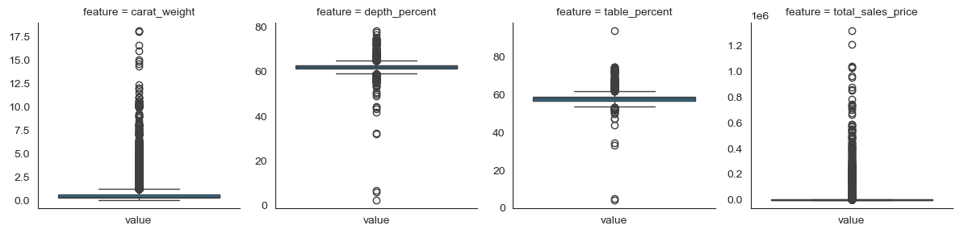
Finding outliers
Boxplots of the 4 truly numeric columns…
…are really messy.

Slide 17
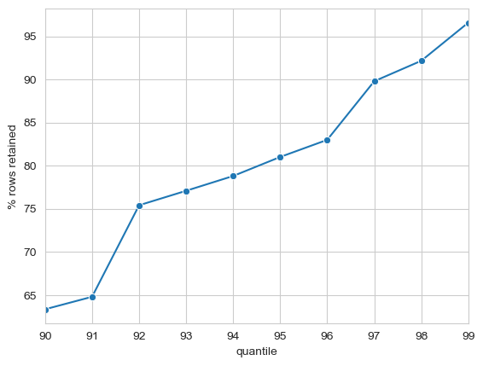
Trying specific quantiles instead
For a given quantile q
0.90 ≤ q ≤ 0.99
define an outlier as a value exceeding the feature’s cutoff value for q.
If I exclude any row that has an outlier, how many/what percent of rows am I retaining?

Slide 18
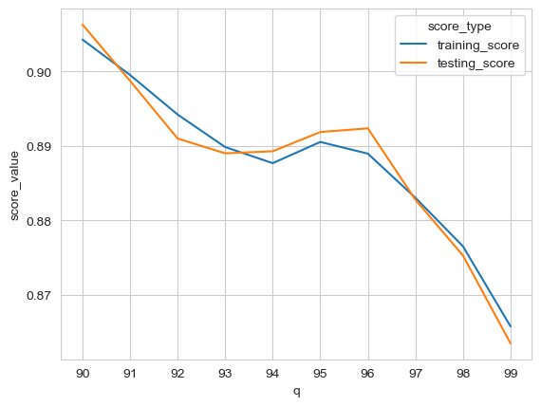
10 variations of linear regression
One for each value of q.
R² scores
Considerable improvement from previous score of 0.62, even when dropping only 3% of data.
q
% of data retained
63%
65%
75%
77%
79%
81%
83%
90%
92%
97%

Slide 19
Final conclusions
Data set has clear separation between fancy/clear diamonds.
Choice of distance metric did not have much impact.
About 90% of the variation in price of clear diamonds can be explained.
It would be interesting to explore applying one of the regression penalties (Ridge, Lasso).

